Slide 1


Slide 2
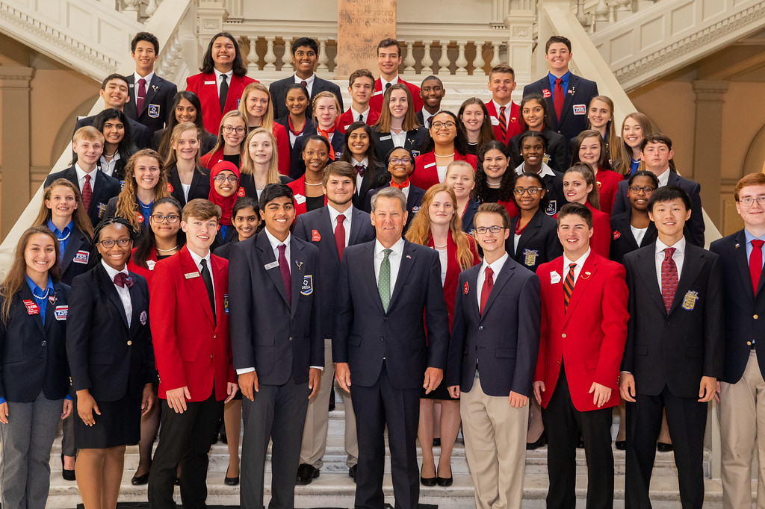









Georgia Career and Technical Student Organizations
2016-2017
Notes:
9 CTSOs recognized as Georgia CTSOs by the DOE

Slide 3
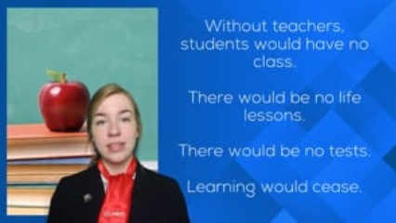

Slide 4
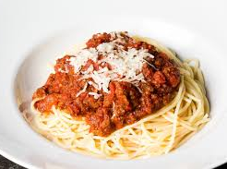
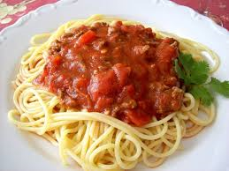
Extra-Curricular: used to describe extra activities that can be done by the students in a school but that are not part of the regular schedule of classes

Slide 5

Co-Curricular: being outside of but usually complementing the regular curriculum

Slide 6
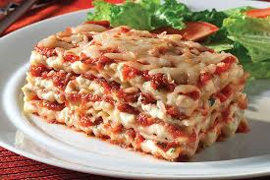
Integral: very important, necessary; essential to completeness

Slide 7
Org | Applicable Clusters
CTI | All CTAE Career Clusters and Pathways (serving students with disabilities)
DECA | Marketing Hospitality
FBLA | Business Management &Administration Finance Information Technology
FCCLA | Education and Training Hospitality and Tourism Human Services
FFA | Agriculture, Food & Natural Resources
FIRST | Science, Technology, Engineering, Mathematics
HOSA | Health Science
SkillsUSA | Architecture & Construction Arts, A/V Technology & Communications Transportation, Distribution & Logistics Human Services Law, Public Safety, Corrections & Security
TSA | Science, Technology, Engineering, Mathematics Energy Manufacturing Arts, A.V Technology& Communications
Notes:
More than 100 Career Pathways fall into the 17 career clusters and this is how they BEST align to the CTSOs. This is based mainly on the alignment of competitive events to the Georgia Performance Standards.

Slide 8
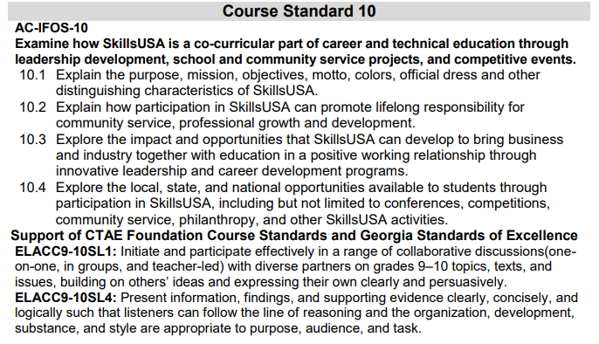
Embedded in all CTAE Course Standards

Slide 9
National Research Center for CTE
…the more students participate in Career and Technical Student Organization (CTSO) activities, the higher their academic motivation, academic engagement, grades, career self-efficacy, college aspirations and employability skills.

Slide 10
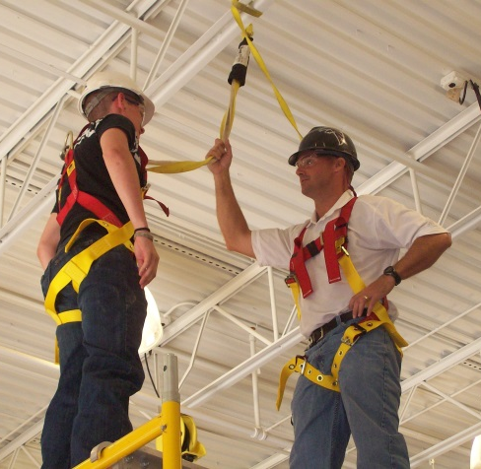
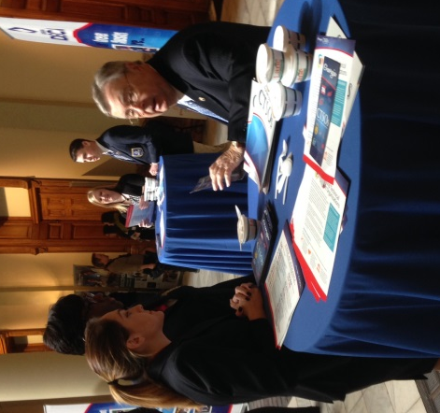
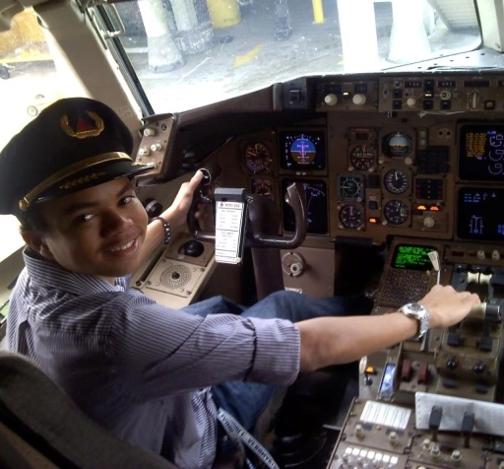
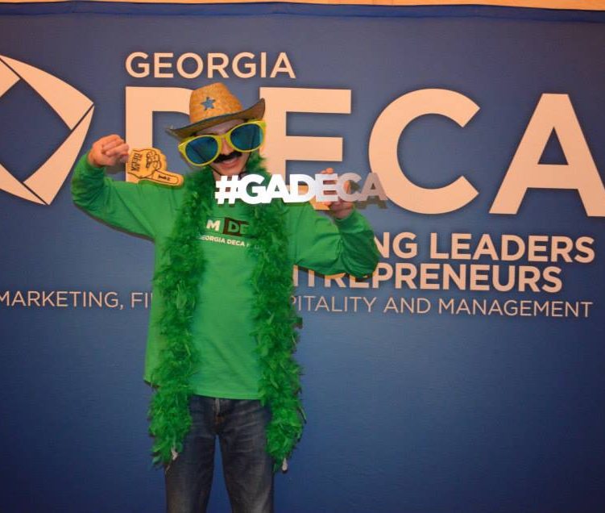
Each element of the diagram is a distinct part of the CTAE division, but they are so fully intertwined that they cannot be fully separated if a complete program is to be offered.
♦ Professional Development
♦ Curriculum
♦ Webinars
♦ Case Studies
♦ Classroom Activities
♦ CDs from National Office
♦ Online Materials – State & National
Notes:
Encourage teachers to reach out for resources in all of these formats! Work Smarter, Not Harder!

Slide 11
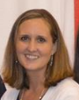

MARKETING EDUCATION
Marketing
Hospitality & Tourism
DOE
CTSO
Vacant
Program Specialist
rivey@doe.k12.ga.us
Shannon Aaron
Executive Director
georgiadeca@gmail.com

Slide 12
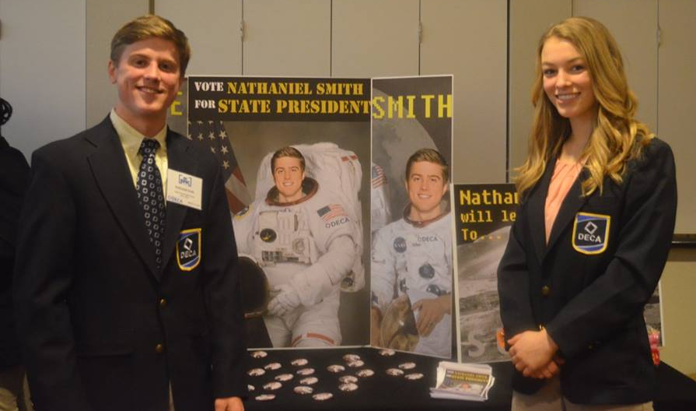

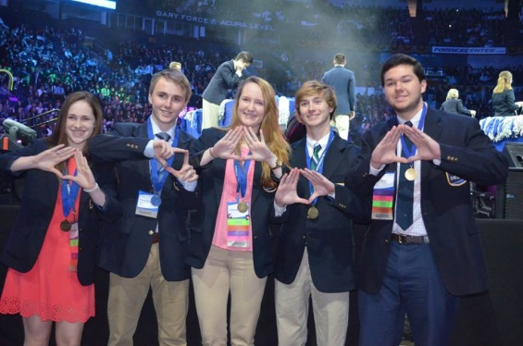
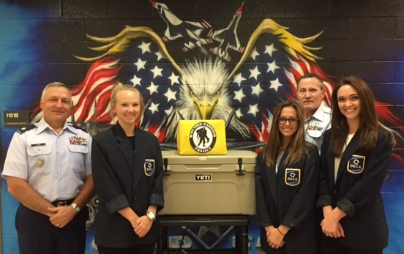
Founded in 1944
Georgia DECA is the 3rd largest chartered association with 13,323 members in 152 active chapters
Home of 4 out of 10 largest chapters in the world

Slide 13
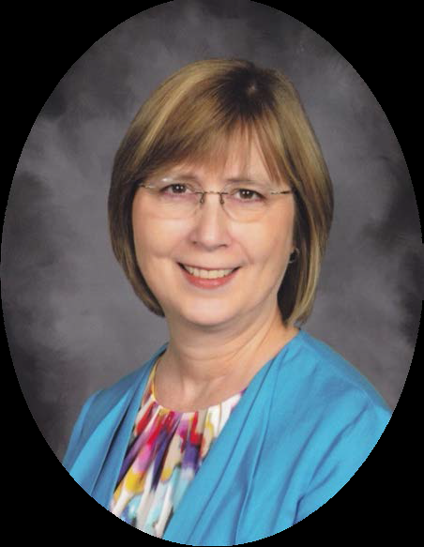
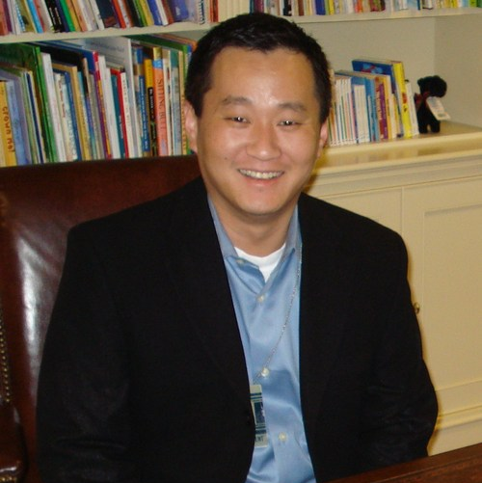

BUSINESS & COMPUTER SCIENCE
Business Management and Administration
Finance
Information Technology
DOE
CTSO
Delda Hagin
Program Specialist
dhagin@doe.k12.ga.us
Monty Rhodes
Executive Director
monty@georgiafbla.org

Slide 14
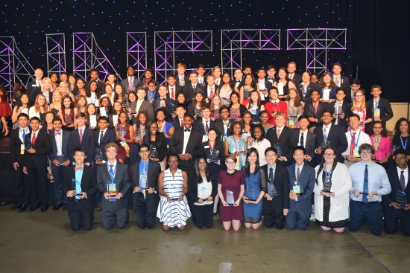

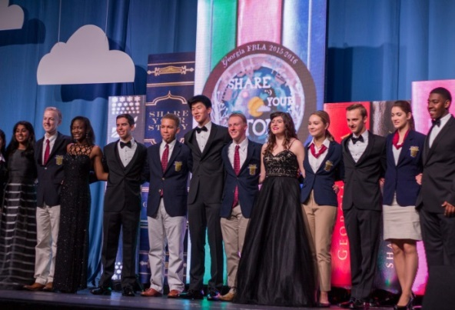
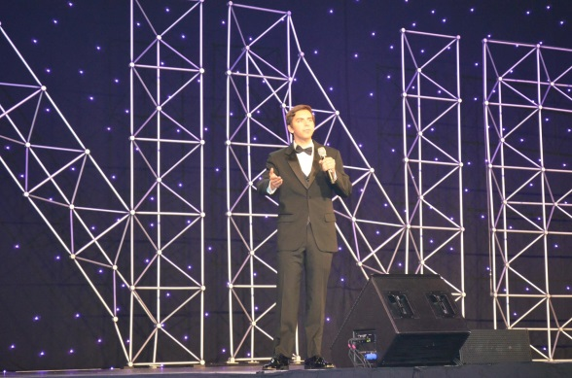
Founded in 1942
Georgia FBLA has 20,661 members
Active chapters in 90% of public schools in Georgia

Slide 15
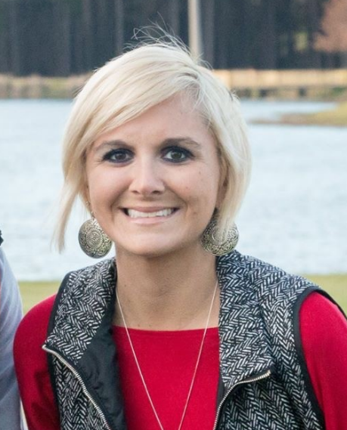

FAMILY & CONSUMER SCIENCES
Hospitality & Tourism (Culinary)
Education & Training
Human Services (FACS)
DOE
CTSO
Linsey Shockley
Program Specialist
lshockley@doe.k12.ga.us
Vacant
Executive Director
gafccla@gmail.com

Slide 16
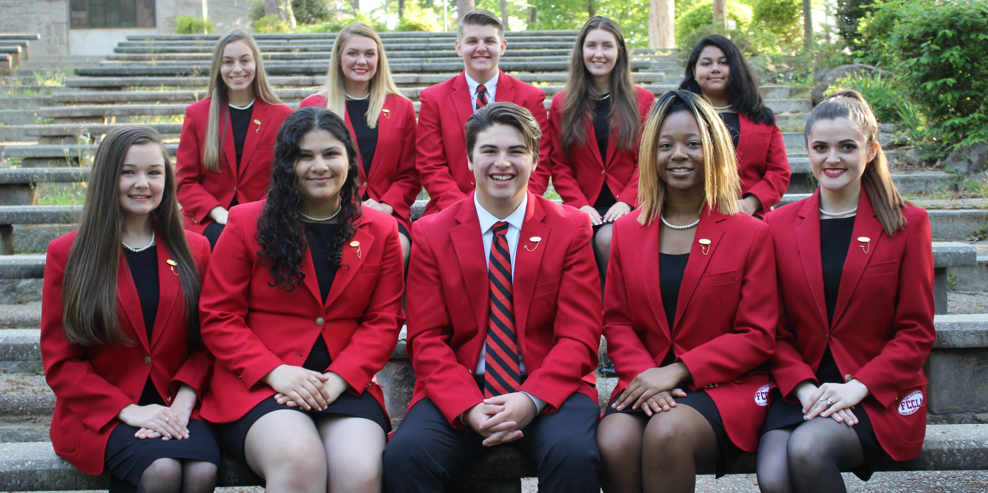
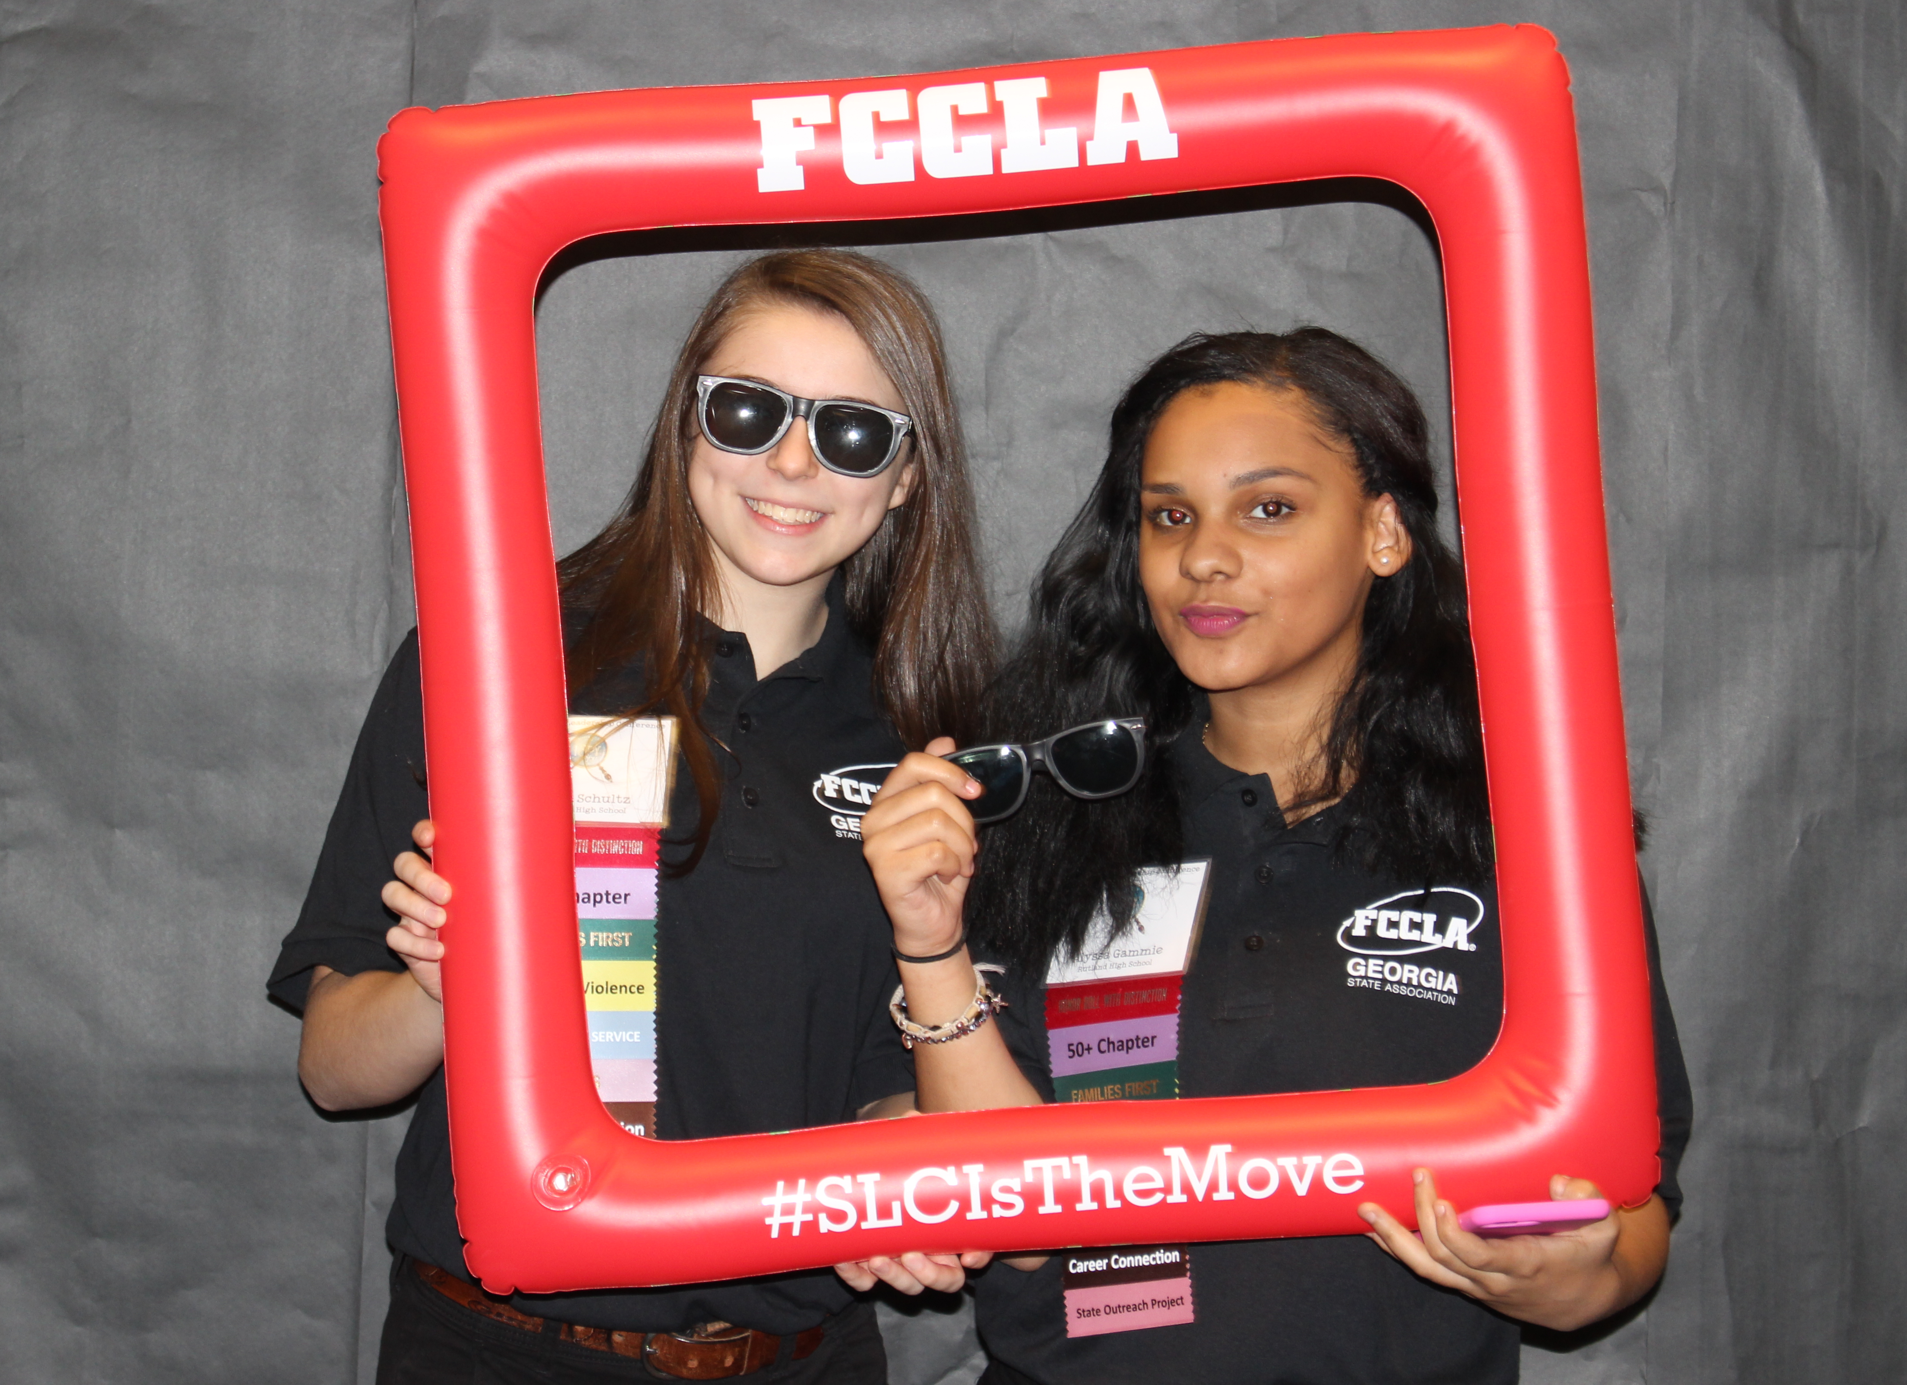
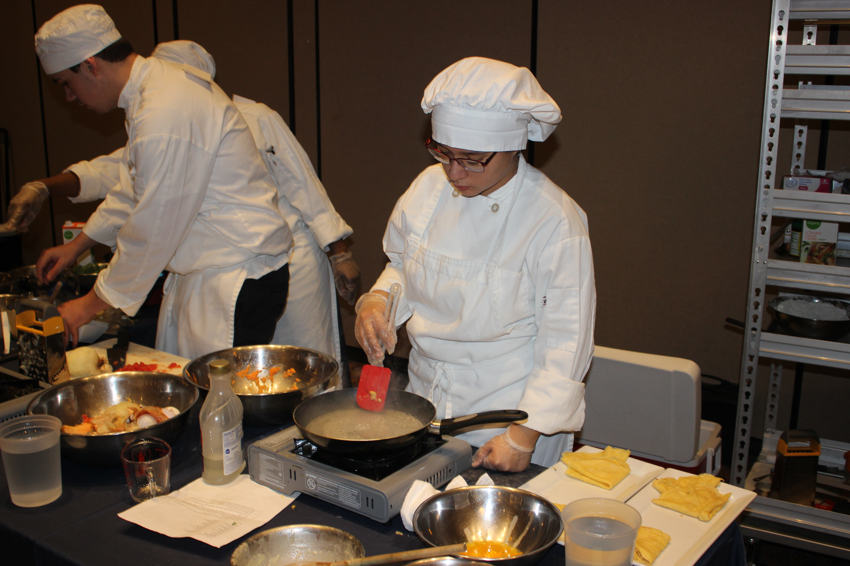
Founded in 1945
Georgia FCCLA has 30,142 members in 296 active chapters (Largest)

Slide 17
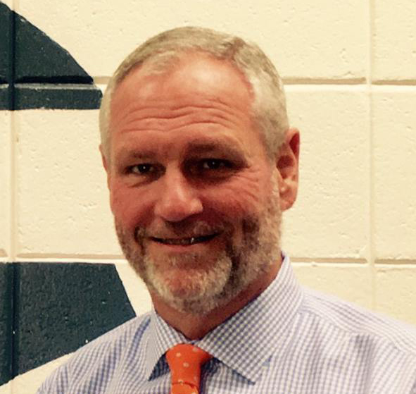
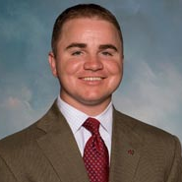

AGRICULTURAL EDUCATION
DOE
CTSO
Billy Hughes
Program Specialist
bhughes@gaaged.edu
Ben Lastly
Executive Secretary
blastly@gaad.edu

Slide 18
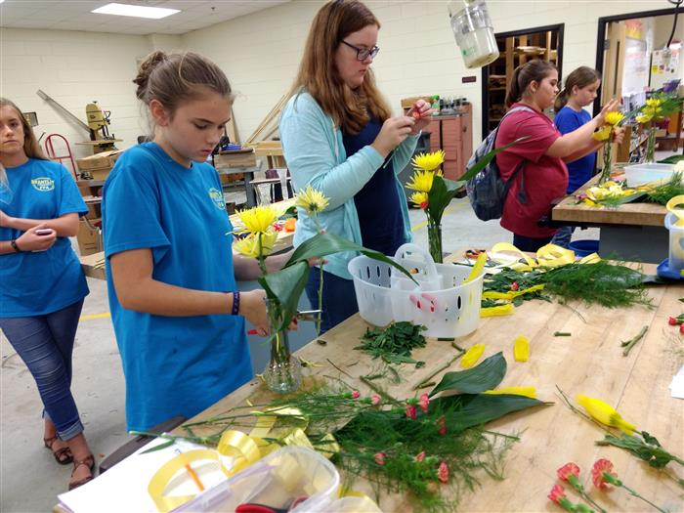
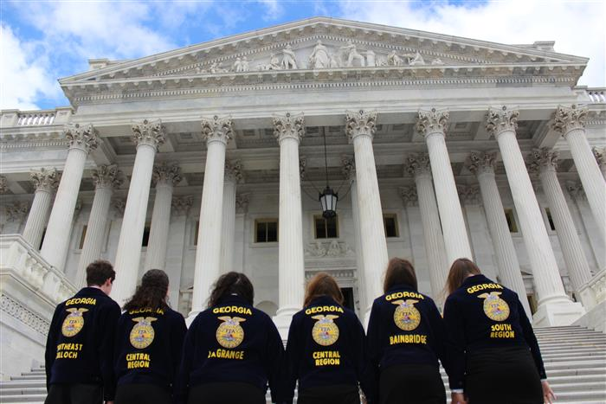
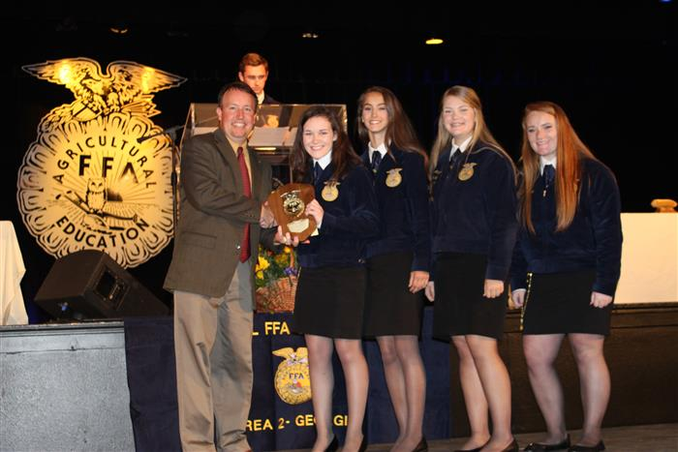
Founded in 1929
Georgia FFA has 73,674 members
Has increased membership for 20 consecutive years
122 of Georgia’s 317 chapters are middle school chapters

Slide 19
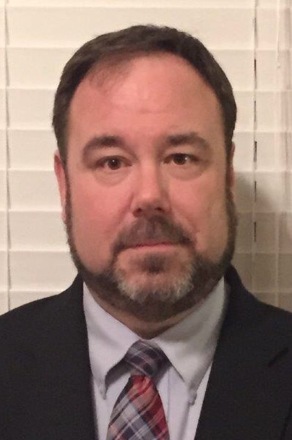
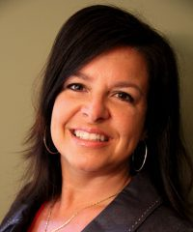

ENGINEERING &
TECHNOLOGY EDUCATION
Manufacturing
Energy
Science, Technology, Engineering & Mathematics
DOE
CTSO
Roger Ivey
Program Specialist
rivey@doe.k12.ga.us
Connie Haynes
Executive Director
chaynes@gafirst.org

Slide 20
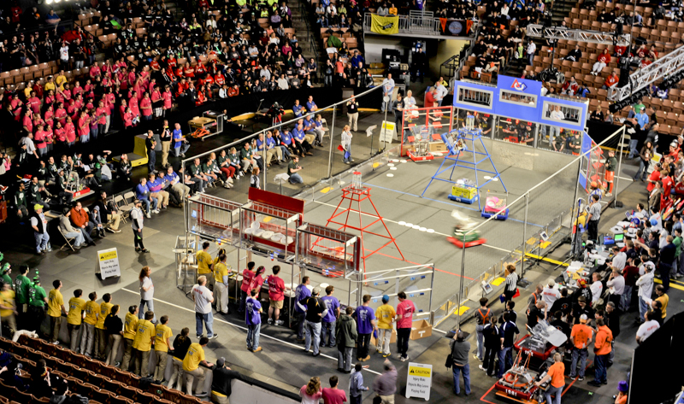

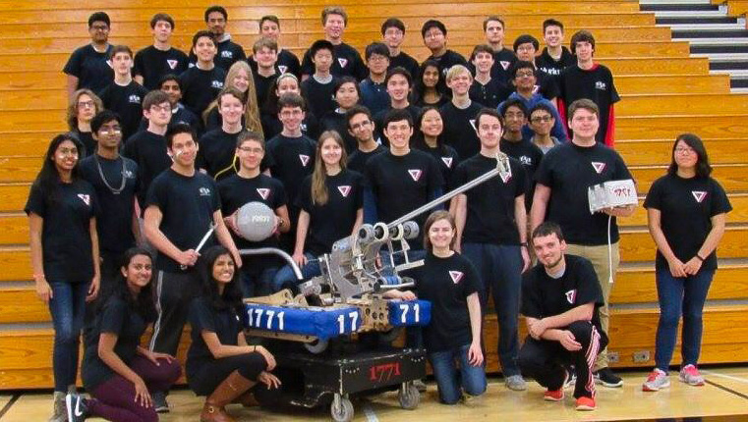
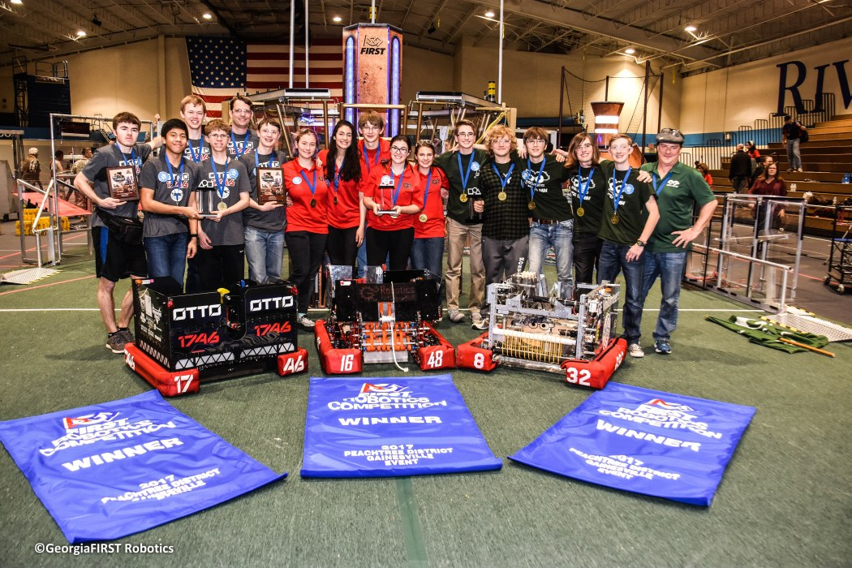
Founded in 2003
Over 1,600 Georgia FIRST Robotics Competition (FRC) Team Members
Georgia FIRST Robotics Competition Members are eligible for over $50,000 in scholarship awards

Slide 21
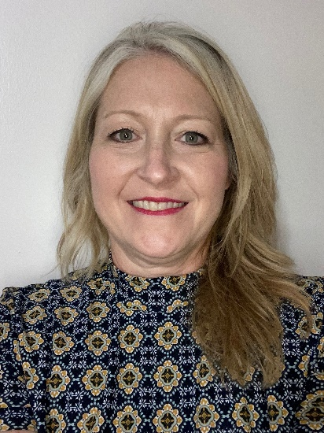
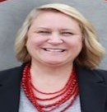

HEALTH SCIENCE EDUCATION
Health Sciences
DOE
CTSO
Sandra Martin
Program Specialist
Sandra.martin@doe.k12.ga.us
Nikki Bentley
Executive Director
nbentley@georgiahosa.org

Slide 22
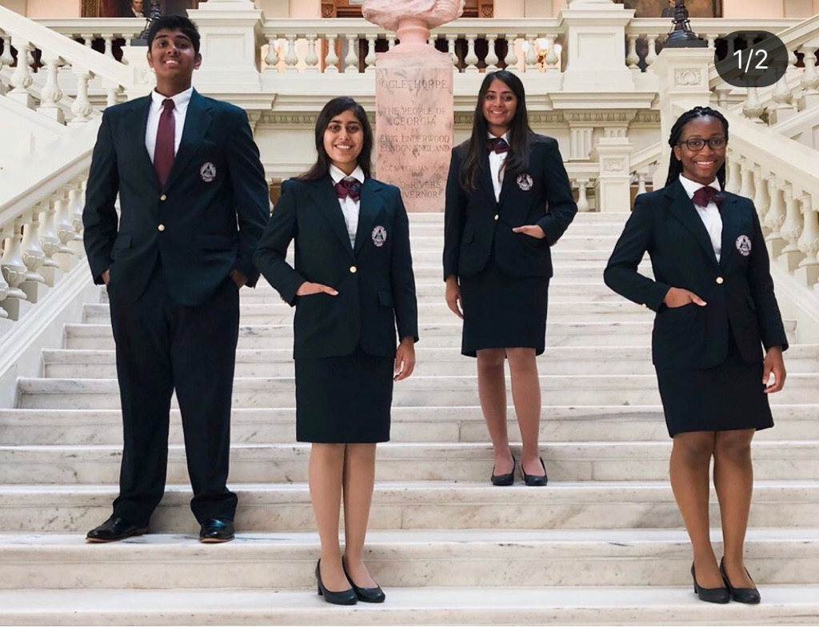
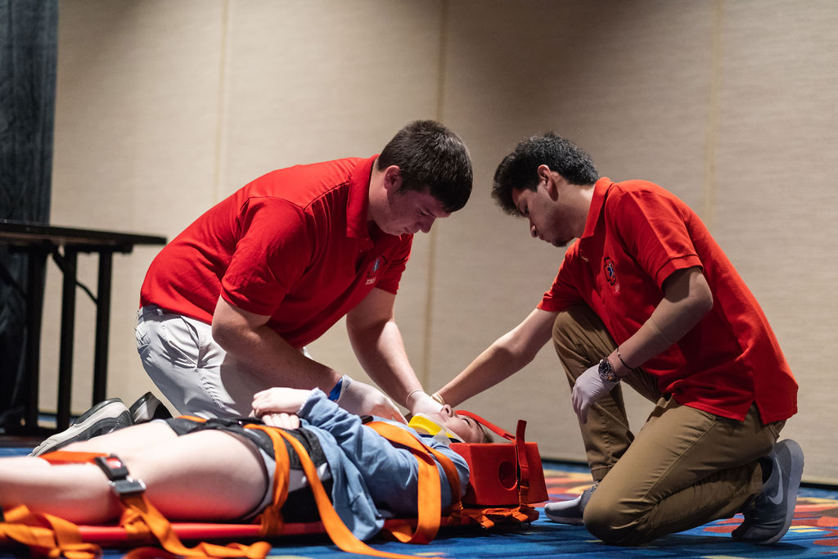

Founded in 2000
3rd largest state affiliate in the world with 14,059 members in 235 active chapters
Largest middle school chapters in the world

Slide 23

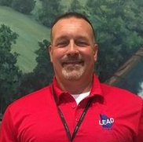
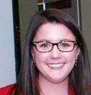
TRADE & INDUSTRIAL EDUCATION
Architecture & Construction Arts
A/V Technology & Communication
Transportation, Distribution & Logistics
Human Services (Personal Care/Cosmetology)
Law, Public Safety, Corrections & Security
DOE
DOE
CTSO
Sandra Martin
Program Specialist
Sandra.martin@doe.k12.ga.us
Tim Elliott
Program Specialist
telliott@doe.k12.ga.us
Ashley Brown
Executive Director
abrown@skillsusageorgia.org

Slide 24
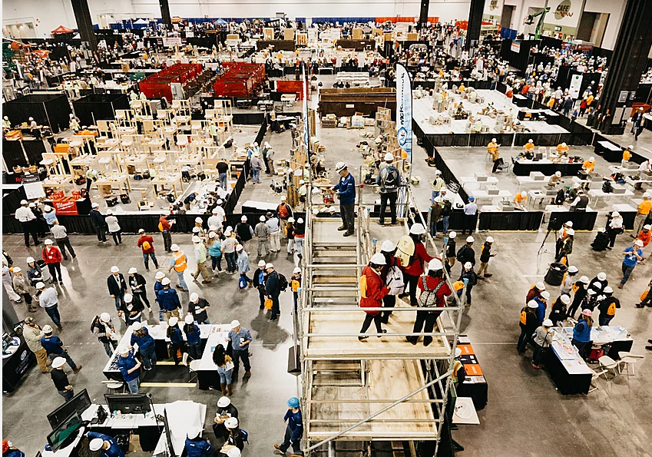
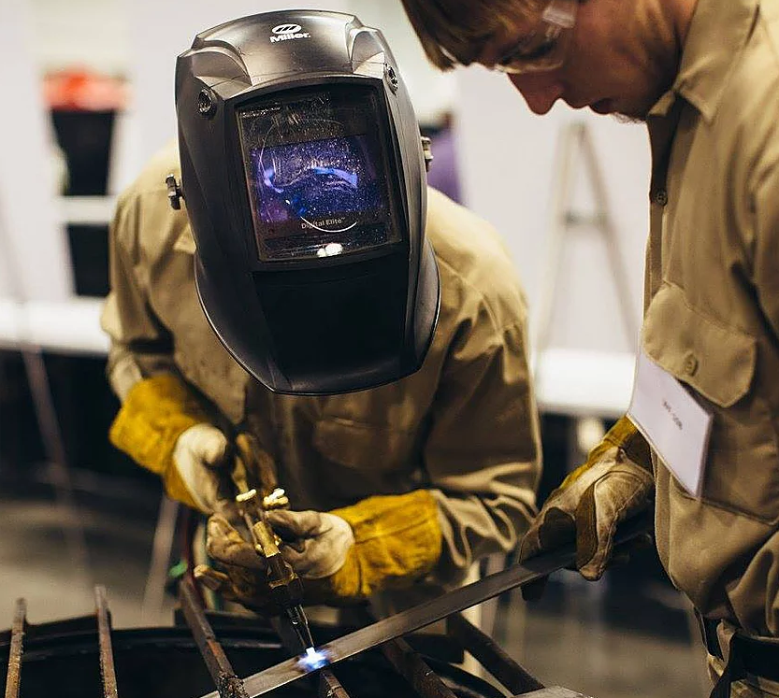
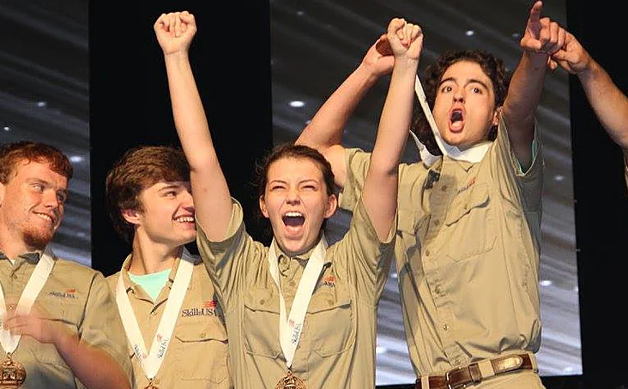
Founded in 1965
8,520 members in 236 active chapters
In 2019, Georgia hosted the largest State Leadership and Skills Conference and Career Expo with 7,315 total attendees

Slide 25
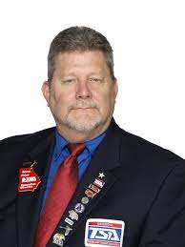

ENGINEERING &
TECHNOLOGY EDUCATION
Manufacturing
Energy
Science, Technology, Engineering & Mathematics
DOE
CTSO
Roger Ivey
Program Specialist
rivey@doe.k12.ga.us
Steve Price
Executive Director
sprice@gatsa.org

Slide 26
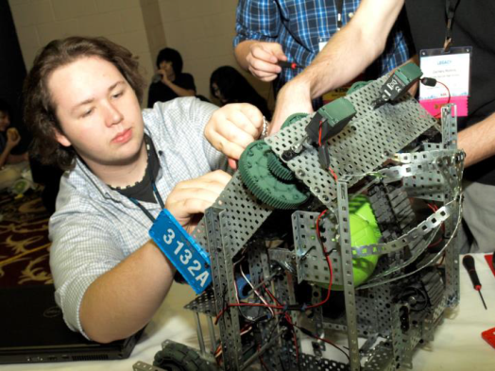

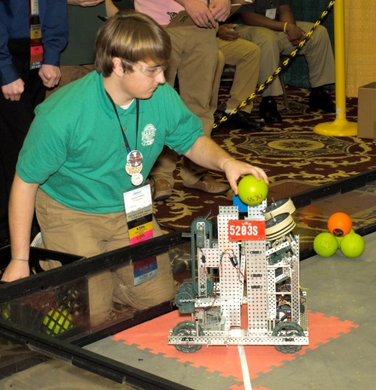
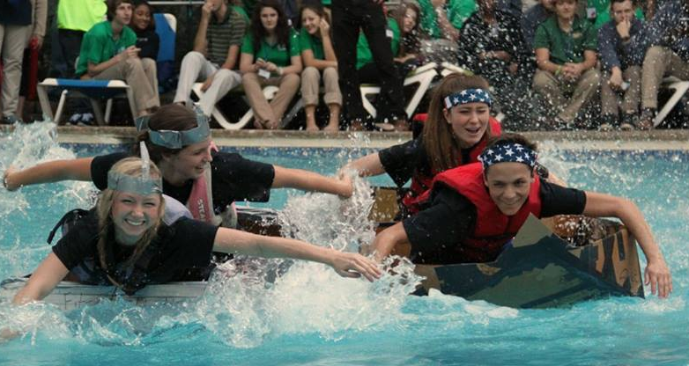
Founded in 1963
21,057 members with 247 chapters 3rd highest membership nationwide
Georgia TSA has the most high school and middle school chapters in the nation.

Slide 27
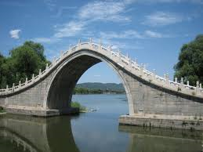


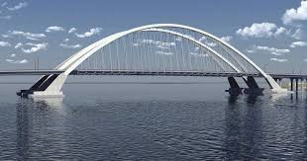

Slide 28

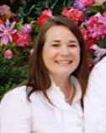

SPECIAL POPULATIONS
Special Populations
CCAE/Project Success
CTI
DOE
CTSO
Paula Poulicek
Program Specialist
ppoulicek@doe.k12.ga.us
Mary Donahue
Executive Director
georgiacti@gmail.com

Slide 29
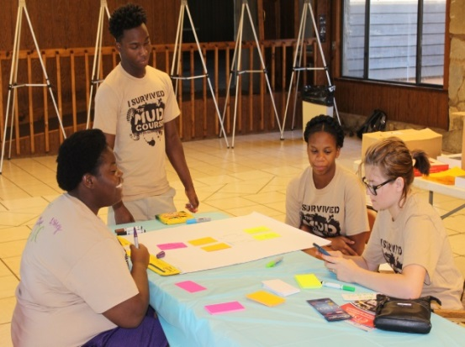



Founded in 1975
Georgia is the only state to offer a CTSO serving students with disabilities enrolled in CTAE programs.
Serving 4,000 students in 70+ programs.
2016 graduation rate for CTI students is 90% (state rate of 36.5% for students with disabilities)

Slide 30



















Slide 31

www.gactso.org
Portal to all CTSO Websites
Membership Chart
CTSO Information Guide
Administrators Guide to CTSOs
CTSO Competitive Events Alignment (being updated)
Master Calendar
Champions/Brag Sheets

Slide 32
Program of Work
Instructor
Vs.
Chapter
Notes:
1) Making sure your teachers understand there is a difference, but that they should be very similar
2) You may email Executive Directors if you feel you need for information regarding deadlines or conference related to the POW

Slide 33
Professional Development
Activities that help students learn leadership and work-related skills
  Hosting an industry guest speaker, attend a local government meeting, attend a college fair at a CTSO conference, competitions
Employability
Activities that increase members’ awareness of quality job practices, attitudes, opportunities for employer contact and eventual employment
    Mock job interviews, résumé writing workshops, career fair at school
Community Service
  Activities that improve the quality of our school and community
  A local park cleanup event, collect canned food for local shelter, coat drive
Fundraising
Activities that raise the funds necessary for our chapters to operate

Slide 34
Competitions
Provide opportunities to demonstrate leadership and technical skills
Public Relations
Activities that make the general public aware of member accomplishments and contributions to our school and the community
  Board of education presentation with video of chapter activities, local administration, teacher appreciation luncheon
  Facebook, Twitter, posters, t-shirts, newsletters, etc.
Social Activities
Activities that create opportunities for members to meet others in their school and community
  Ice cream social, pizza party, karaoke night, theme park
Membership
What about it?
  Enrollment Night (Fall) / Open House (Spring) / First Week of School

Slide 35
Rule #1:
Make it work for the classroom.

Slide 36
Rule #2:
Make it work for administrators.

Slide 37
Rule #3:
Make it work for students and parents financially.

Slide 38
Rule #4:
Make it work for stakeholders.

Slide 39
Rule #5:
Make it work for family/life.

Slide 40


Slide 41




Lynsey Singleton
(404) 210-8810
Georgia CTSO/JROTC Program Specialist
Lsingleton@doe.k12.ga.us

